Slide 1

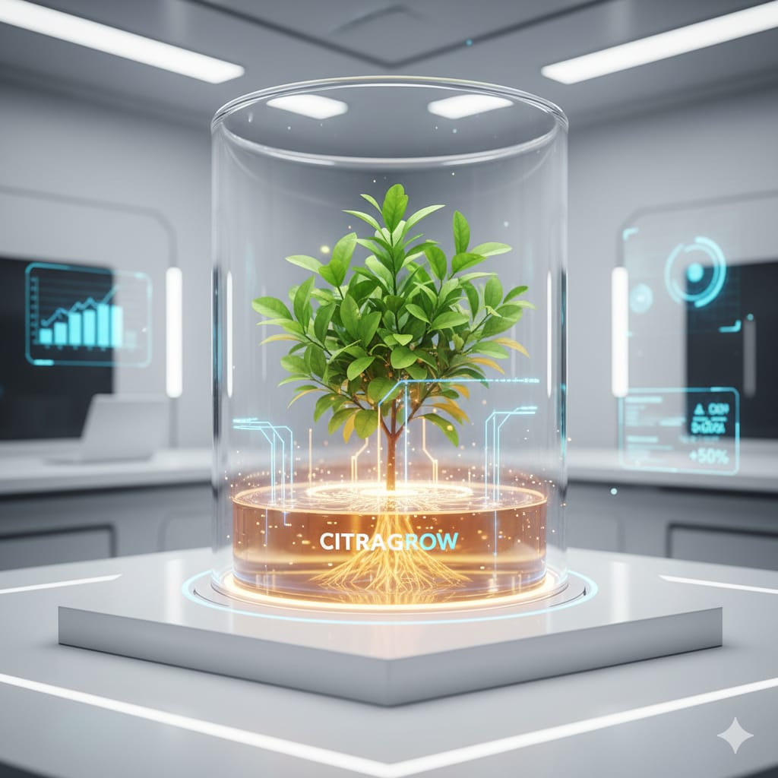
Tinkering & Mentoring - VACC 201
Problem Identification, Ideation & Initial Design
Name Of The Product
CITRAGROW
"Growing Sustainably for Tomorrow"

Slide 2
CITRAGROW
Student Team
Name | Enrollment No. | Key responsibilities
PARMAR MAHI | 25sc02044 | MANAGEMENT , TRACK PROGRESS
PARMAR NIRMAL | 25sc02045 | RAW MATERIAL COLLECTION &PRE-PROCESSING LEAD
PARMAR SHRUSTI | 25sc02046 | APPLICATIONS,IMPACT AND REAL WORLD REVELANCE
PATEL DAX | 25sc02047 | LITERATURE REVIEW& THEORY SPECIALIST (BACKGROUND RESEARCHER)
PATEL DHWANI | 25sc02048 | TESTING ,ANALYSIS & QUALITY ASSESMENT
PATEL DHYANI | 25sc02049 | FERMENTATION &PROCESS CONTROL LEAD

Slide 3
CITRAGROW
Faculty Mentor
Name | Designation | Department, School
 | Professor, Department of Life Sciences. Coordinator, Research & Development Cell & NAAC Initiatives.
Dr. Devjani Banerjee
SOS life Sciences

Slide 4

CITRAGROW
Brief of Tinkering Project
Title of Tinkering Project: CitraGrow
Sector: Organic Fertilizer
Brief of Tinkering Project: The project Citragrow focuses on developing a natural organic fertilizer using orange peels, sugar molasses, and water through fermentation. Increasing use of chemical cleaners and fertilizers causes environmental pollution and health issues.
The bio-enzyme can be effectively utilized as an organic fertilizer to improve plant productivity while supporting environmentally sustainable practices.
The bio-enzyme can be used for household cleaning, deodorizing, gardening, and waste management, promoting sustainable living.

Slide 5
CITRAGROW
Objective
🔬Bio-enzyme Preparation
Develop natural fertilizer using orange peels, molasses & water
♻️Waste Management
-Convert kitchen waste into useful eco-friendly product
💰Cost-effective Solution
-Low-cost, non-toxic alternative to chemicals
Soil & Plant Health
-Enhance soil quality and plant growth
🌍 Environmental Protection
-Reduce pollution and promote sustainability
🧪 Scientific Study
-Understand fermentation proces
🏡 Multiple Uses
-Gardening, cleaning, deodorizing, waste management
📢 Awareness
-Promote sustainable lifestyle practices

Slide 6
CITRAGROW
USP/ Novelty/ Unique Points of Tinkering Project
1)WASTE TO WEALTH INNOVATION.
-Citrus waste used as input material.
-Conversation of waste into organic fertilizer.
-Supports sustainable waste utilization.
2)ECO-FRIENDLY AND ORGANIC
-100% Biodegradable formulation.
-Safe for soil and plants.
-Prevents chemical soil damage.
3)LOW-COST AND REPLICABLE.
-Uses locally available materials.
-Minimal equipment required.
-Easy to produce at small scale.
4)SUPPORT TO SUSTAINABLE AGRICULTURE.
-Promotes organic farming practices.
-Reduces dependence on synthetic fertilizers.
-Improves natural soil fertility.

Slide 7

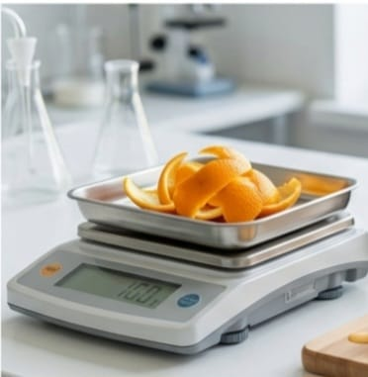
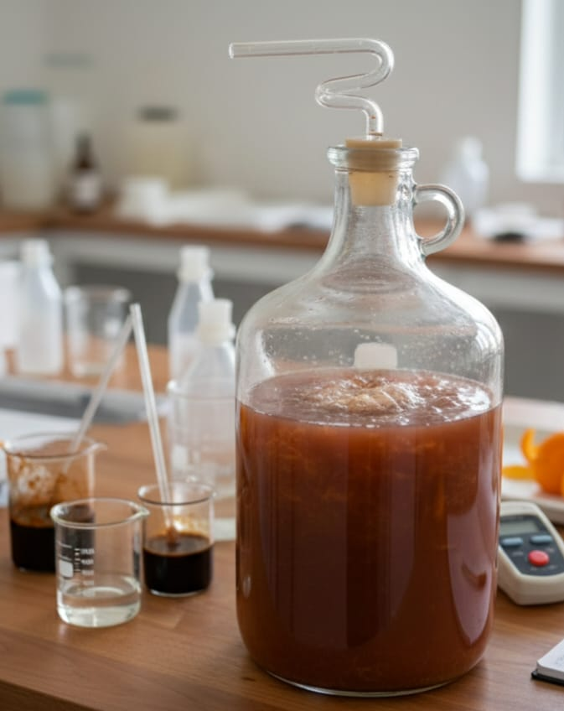
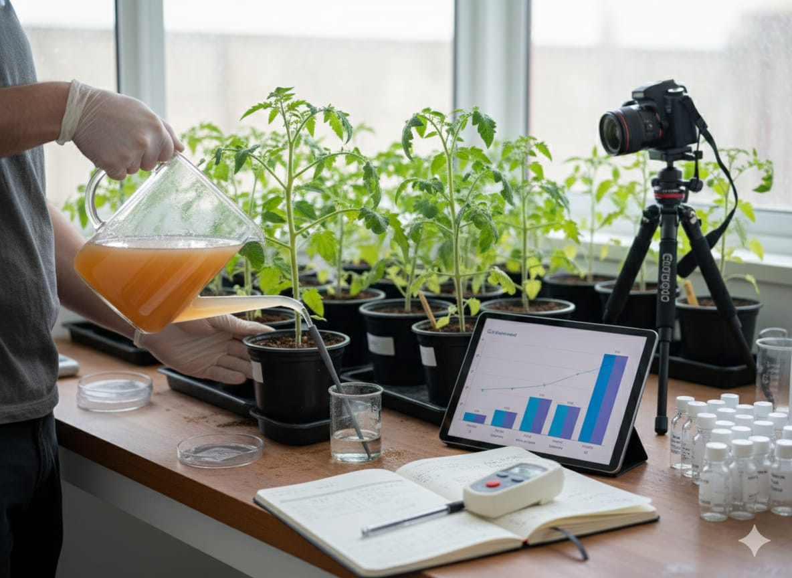
CITRAGROW
Project Timeline & Milestones
Week | Activity | Milestones achieved
Week 1-2 | Collection and preparation of ingredients (150 g orange peels, 150 g lemon peels, sugar/molasses, yeast, water). | Materials prepared and formulation finalized
Week 3-14(3months) | Preparation of solution and fermentation process. | Active microbial fermentation initiated.
Week 15-16 | Filtration, dilution (1:10), observation, application to plants, result analysis, and documentation. Effectiveness of liquid fertilizer evaluated and completed. | Liquid fertilizer ready and applied. Effectiveness evaluated and project completed.

Slide 8
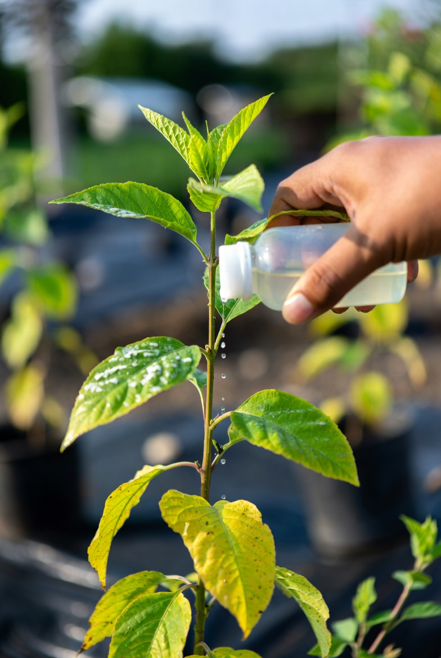
Thank You..

Slide 9
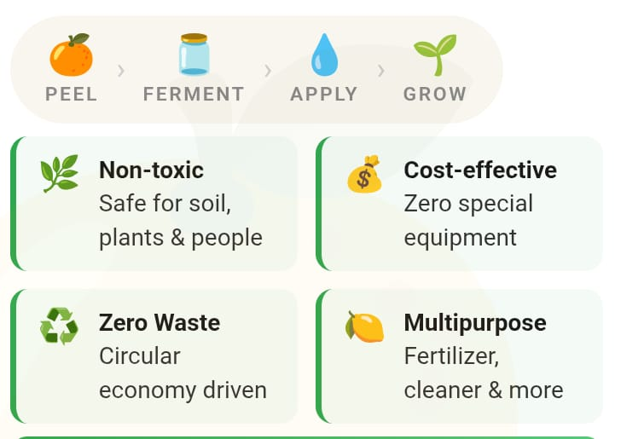
Introduction
CITRAGROW
"Growing Sustainably for Tomorrow“
Chemical fertilizers and synthetic cleaners are silently degrading our soil and polluting our environment — the world needs a smarter, greener alternative.
CitraGrow is a student-driven initiative that upcycles citrus peels (orange & lemon) into a powerful bio-enzyme organic fertilizer, using just three simple ingredients: peels, sugar molasses, and water.

Slide 10
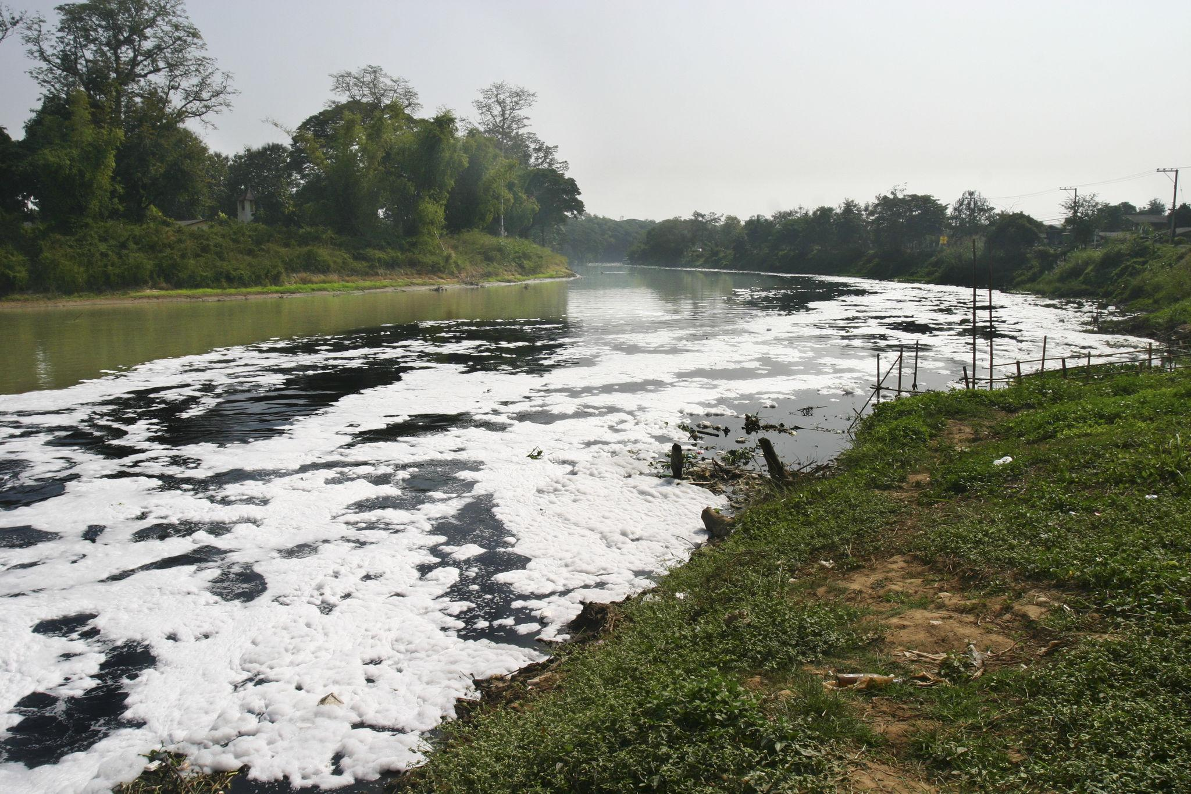
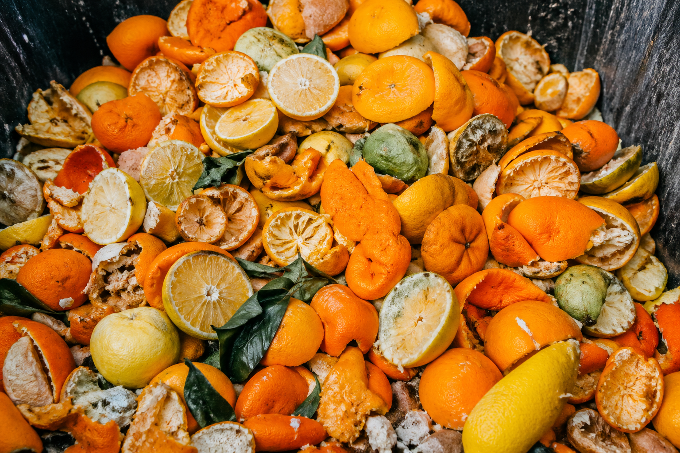
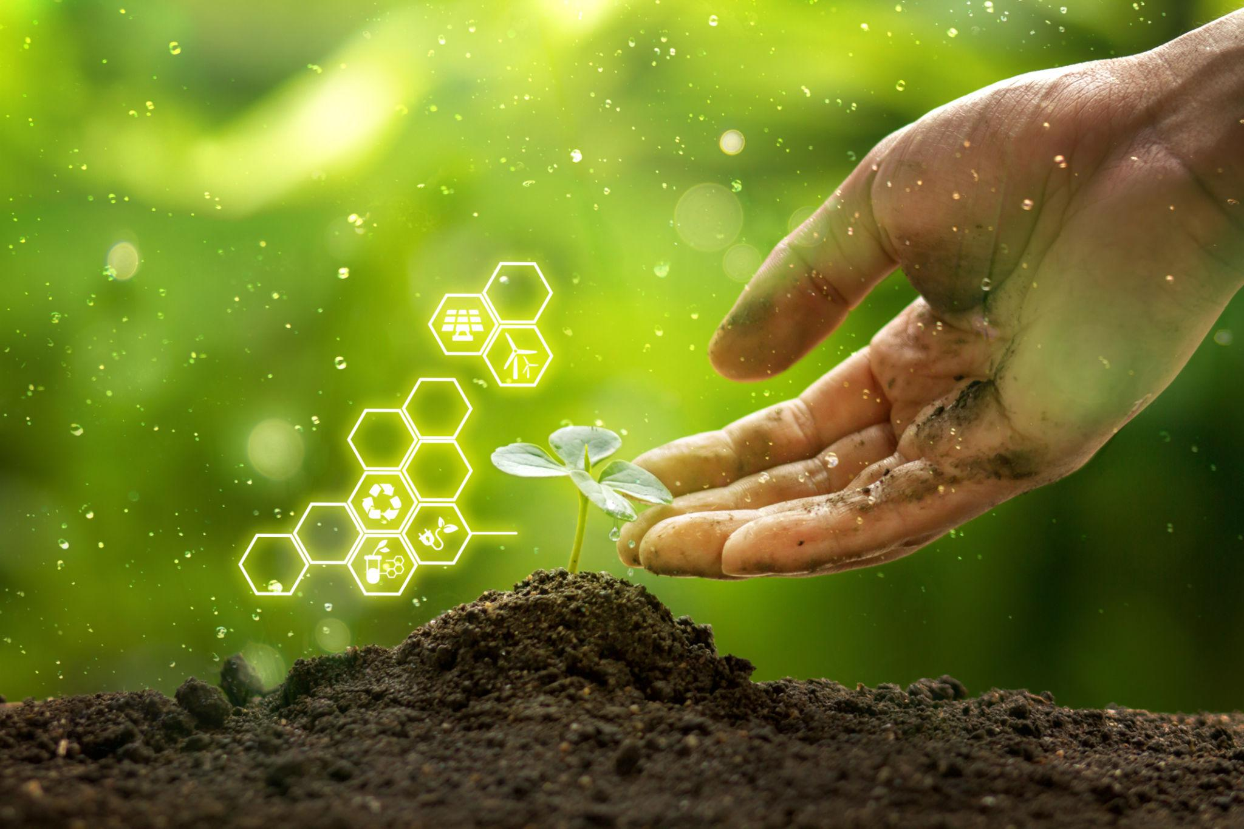
CITRAGROW
The Problem in Depth
Chemical fertilizers degrade soil & reduce microbial diversity.
Synthetic cleaners pollute water & harm aquatic life.
Citrus/kitchen waste overloads landfills.
Our Vision with CitraGrow
Turn waste into an eco-friendly resource.
Support sustainable, organic farming.
Enable zero-waste living at low cost.
Expected Impact
Improved soil health and plant growth.
Less environmental pollution.
Wider adoption of sustainable habits.

Slide 11

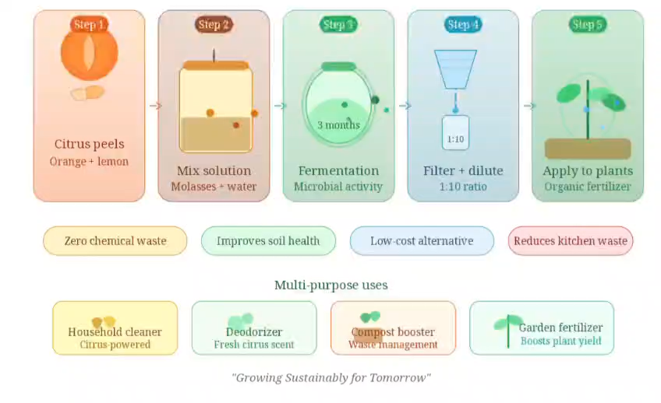
CITRAGROW

Slide 12
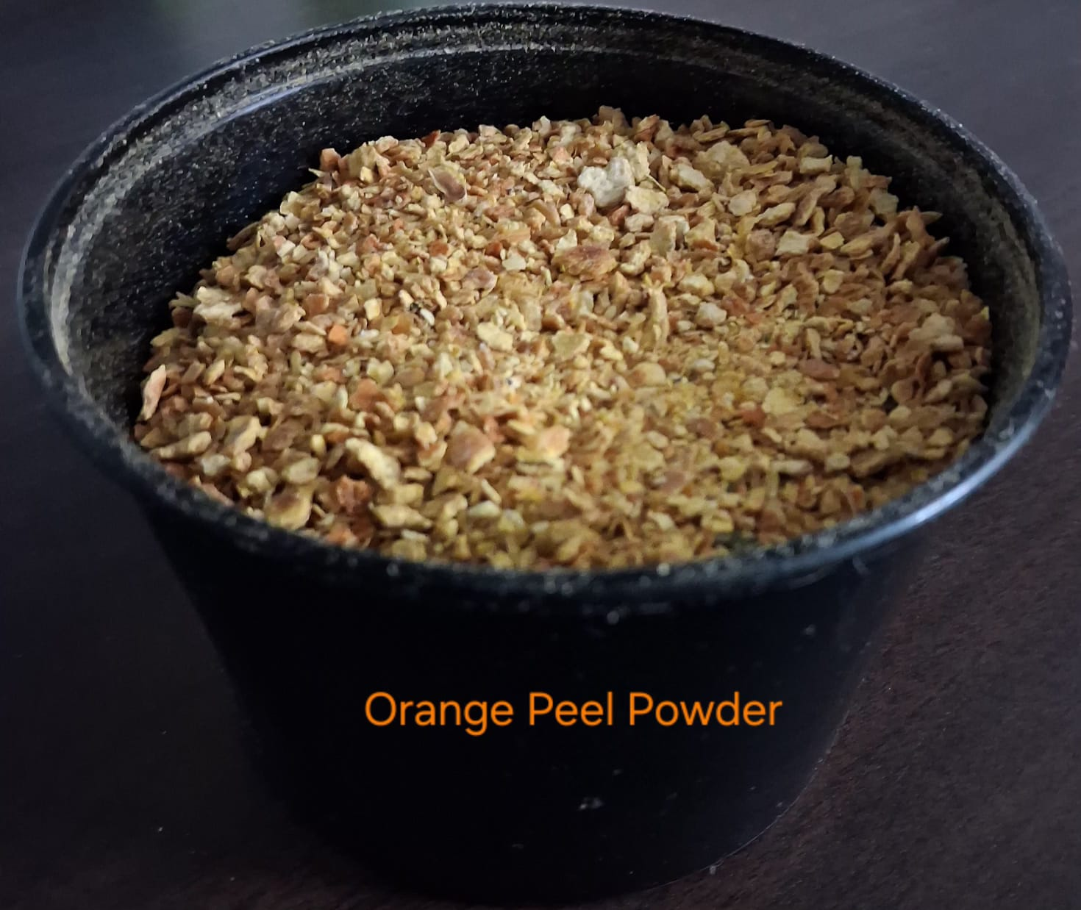
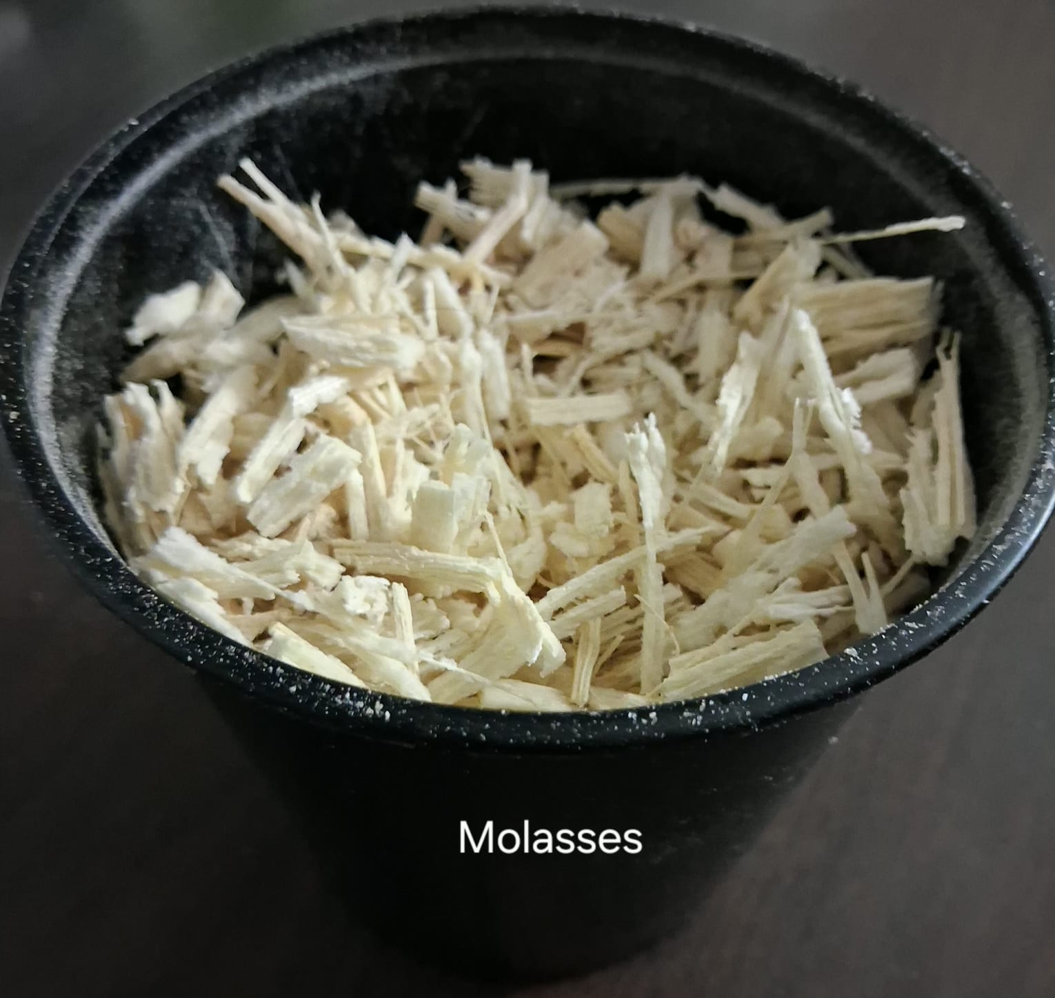
Materials
CITRAGROW
Raw Materials
Orange peel powder (from dried citrus peels)
Jaggery / Sugar molasses
Water
Plant Material
Fenugreek seeds (Methi)
Equipment
Airtight container (for fermentation)
Measuring cup / cylinder
Stirring rod or spoon
Grinder (for peel powder preparation)
Experimental Setup
Plant pots
Soil (same type for all pots)

Slide 13
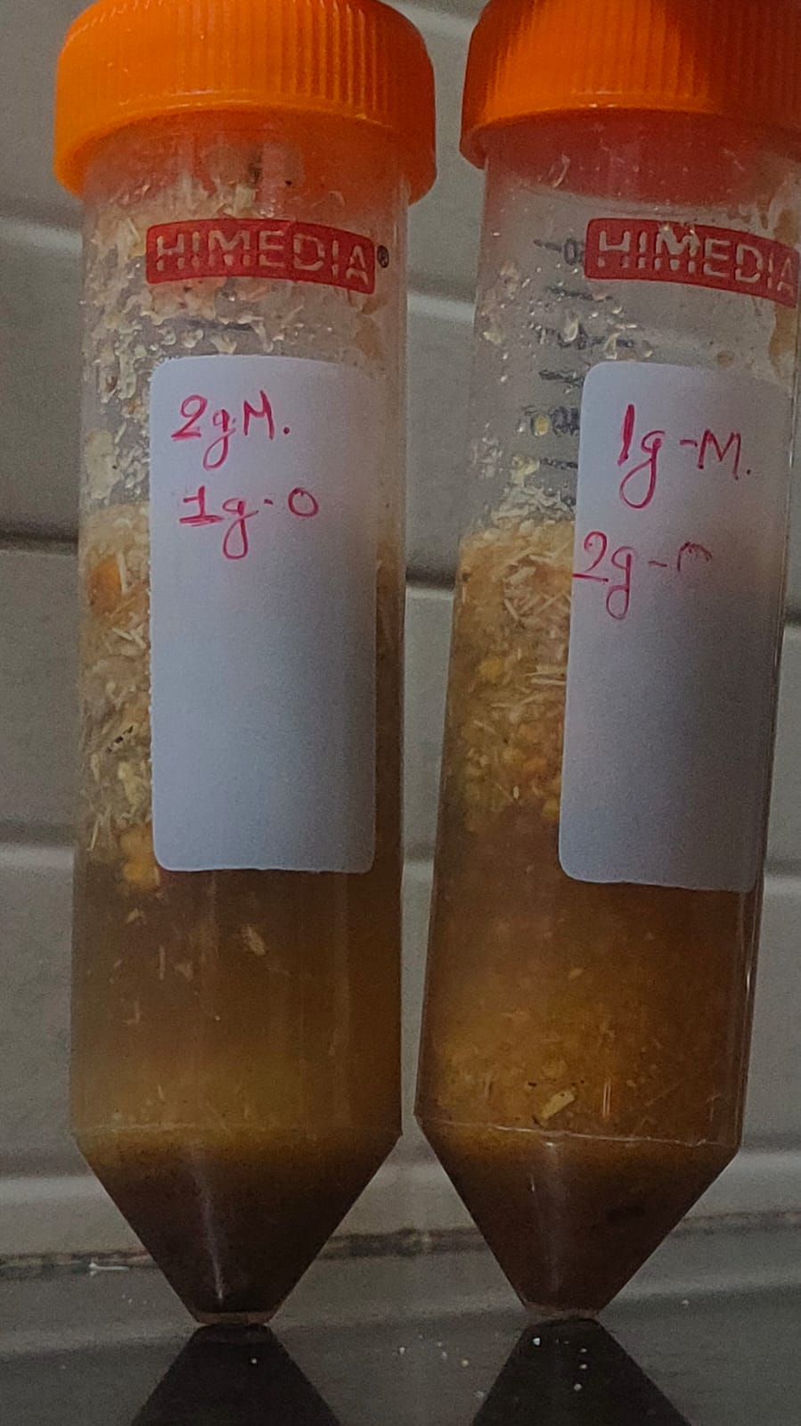
CITRAGROW
Experimental Setup
Control Pot → Soil + Water + Fenugreek seeds (no fertilizer)
Test Pots → Soil + Fenugreek seeds + CitraGrow bio-enzyme
Observation Parameters
Germination rate
Plant height
Number of leaves
Overall plant health
Variables
Independent Variable → Bio-enzyme fertilizer
Dependent Variable → Growth of Fenugreek plants
Controlled Variables → Soil type, water quantity, sunlight exposure, seed type.

Slide 14
Result: Experiment-1
CITRAGROW
Parameter | Date | Control (Water Only) | Treatment 1 (2g Mol + 1g Orange) | Treatment 2 (1g Mol + 2g Orange)
Sowing Day | 12 April | Seeds sown, no germination | Seeds sown, no germination | Seeds sown, no germination
Germination Status | 17 April (Day 5) | Moderate sprouting, curved shoots | Almost no germination, bare soil | Very early, tiny radicles emerging
Germination Status | 21 April (Day 9) | Dense, full germination across pot | Sparse sprouting, scattered seedlings | Very sparse, few seedlings visible
Germination Status | 22 April (Day 10) | Dense, healthy full coverage | ~10–12 scattered seedlings | ~6–8 scattered seedlings
Seedling Color | 22 April | Medium green, healthy | Light green, slightly yellowish | Light green, pale
Germination Status | 27 April (Day 15 Final) | Very dense, tall, full coverage | ~8–10 seedlings, moderate growth | ~6–8 seedlings, sparse growth
Seedling Color | 27 April | Dark green, very healthy | Light-medium green | Light green, pale
Stem Strength | 27 April | Strong, upright stems | Moderate | Weak, thin stems

Slide 15
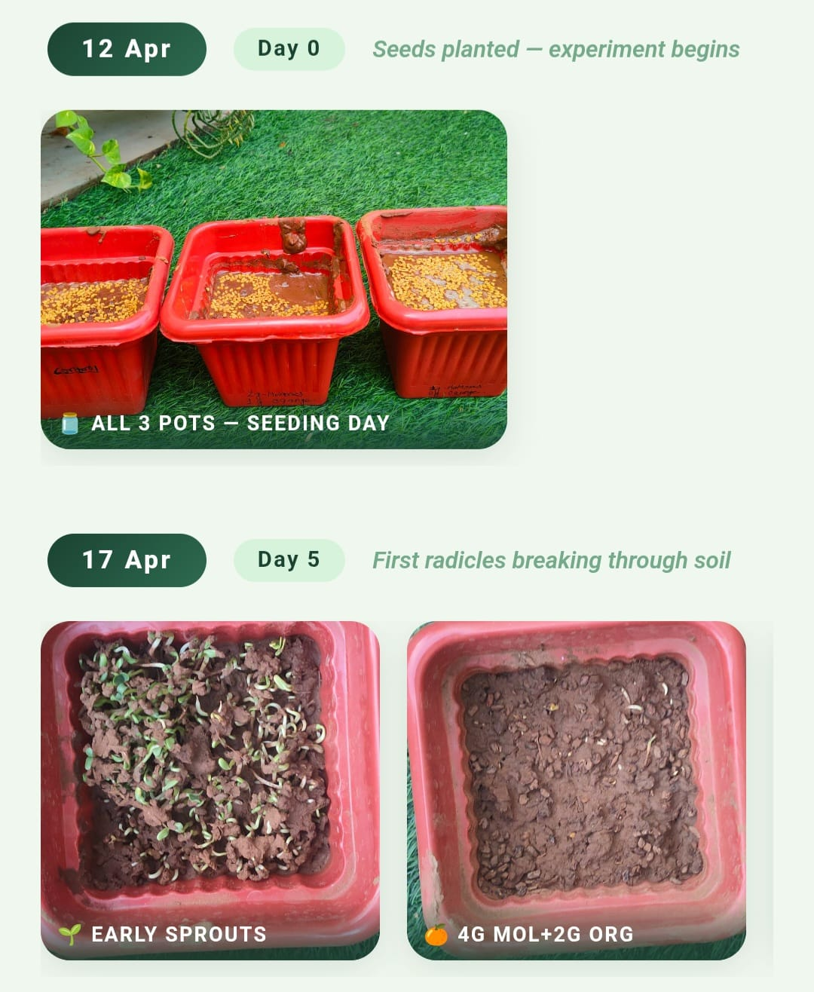
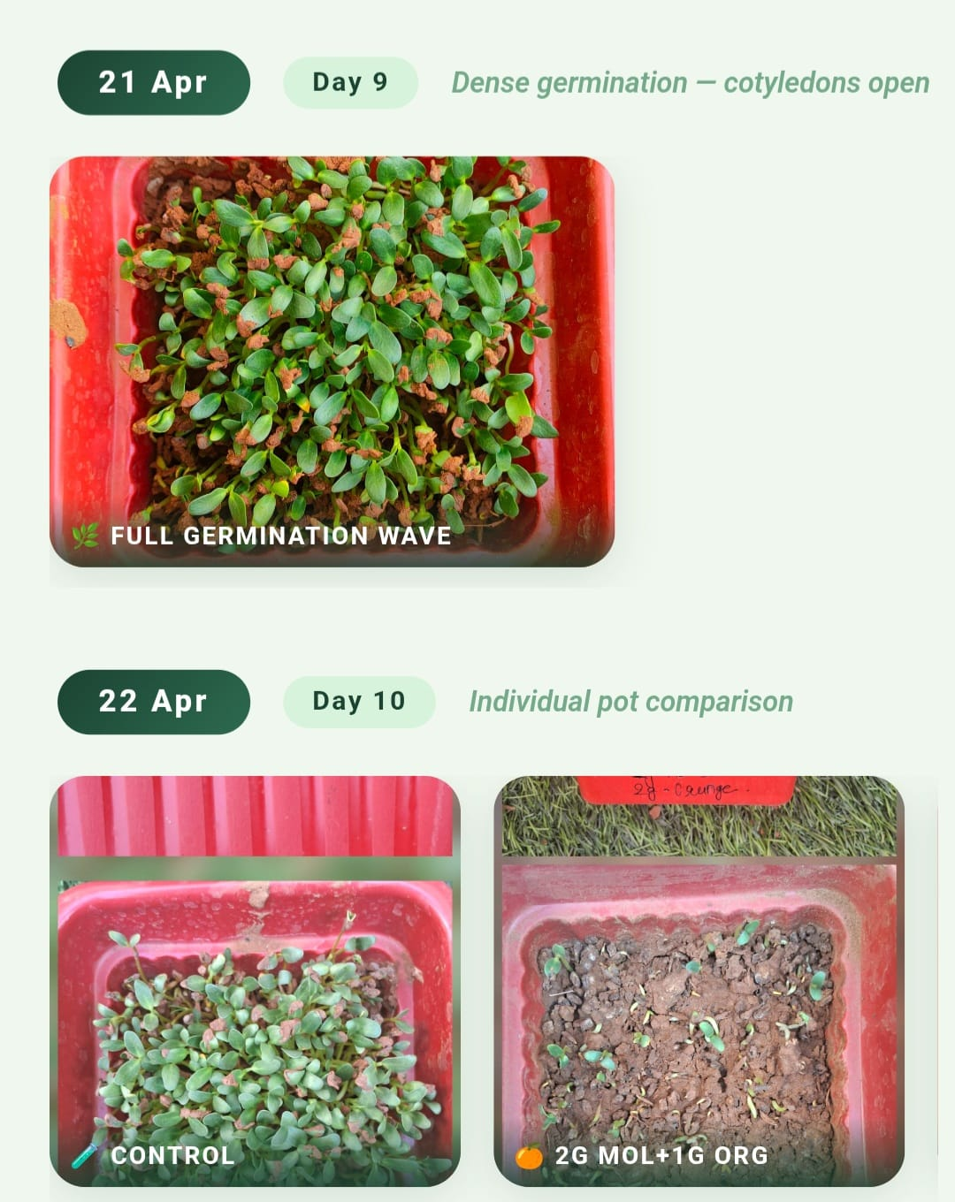
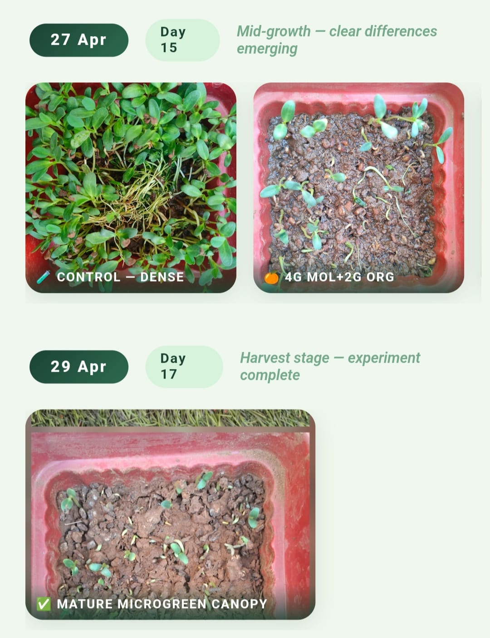
CITRAGROW

Slide 16
Result: Experiment-2
CITRAGROW
Parameter | Date | Control (water only) | Treatment 1 (10ml sol + 10ml water) | Treatment 2 (5ml sol +15ml water)
Sowing Day | 28 April | Seeds sown, no germination | Seeds sown, no germination | Seeds sown, no germination
Germination status | 30 April | Pale green germination. | Delayed germination, very little growth | Delayed germination, almost no sprouts
Germination status | 1 May | Healthy growth | Germination begins, few sprouts | Germination begins, very few sprouts
Germination status | 2 May | Moderate coverage, steady growth | Dense germination, healthy growth | Few sprouts but fast germination
Seedling color | Overall | Green and healthy | Dark green and very healthy | Medium green and healthy
Stem strength | overall | Weak, thin stems | Strong thick stems | Moderately strong stems

Slide 17
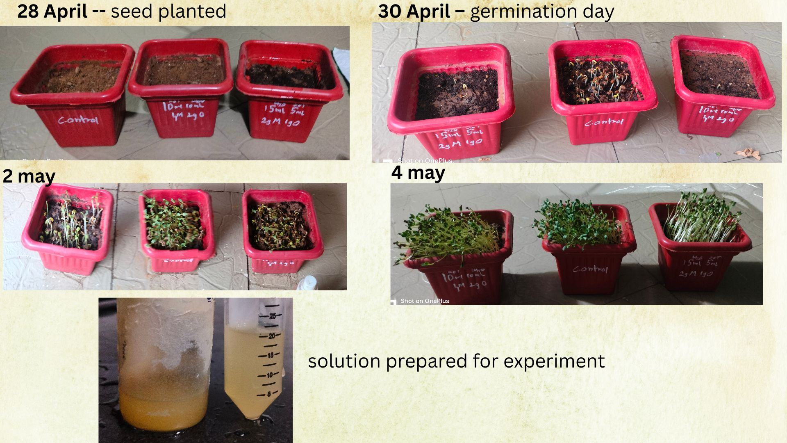
CITRAGROW

Slide 18
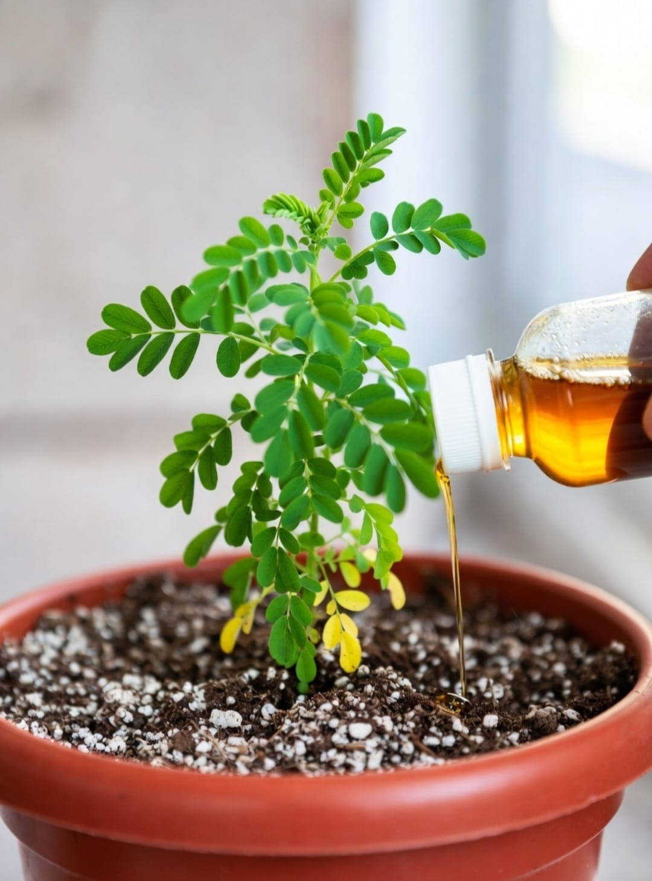
CONCLUSION
CITRAGROW
🧪 CitraGrow in Progress: Bio-enzyme under preparation using orange peels, molasses, and water.
🌱 Ongoing Testing: Currently evaluating its effect on fenugreek seed germination and plant growth.
♻️ Sustainable Approach: Converting kitchen waste into a potential eco-friendly liquid fertilizer.
🌍 Environmentally Friendly: Promotes circular economy by reusing citrus waste and reducing chemical usage.
🏡 Simple & Accessible: Easy homemade method suitable for households and small farmers.
📊 Promising Initiative: Working towards a greener alternative to synthetic fertilizers.
✨ Overall: CitraGrow aims to transform kitchen waste into a natural plant growth promoter through sustainable innovation.

Slide 19
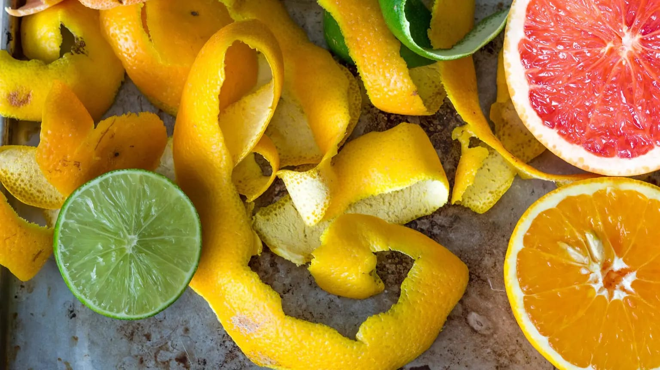
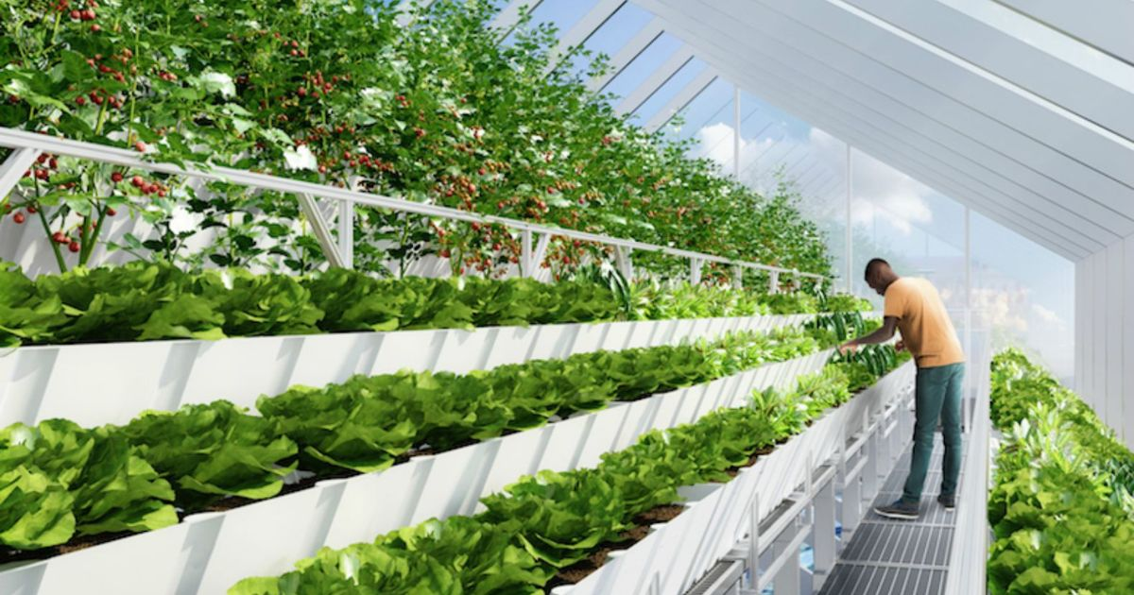
CITRAGROW
Future Scope & Recommendations
Testing Citra Grow bio-enzyme on different plant varieties and crops for wider applicability.
Scaling up production at community and household levels to reduce dependence on chemical fertilizers.
Exploring the use of other citrus peels like lemon and lime for enhanced bio-enzyme production.
Testing Citra Grow as a household cleaner and deodorizer to explore its multipurpose applications.
Conducting soil health analysis before and after bio-enzyme application to measure improvement in soil quality.

Slide 20
CITRAGROW
Thank You..

